Slide 1
Synergy in Shopping: A Blueprint for E-commerce Excellence
Group 4
Mithilesh Menakuru, Megan Mossinger, Rishitha Nimma, Priyanka Verma

Slide 2




Our Team

Slide 3

What is the E-commerce Industry?
E-commerce involves buying and selling goods online globally.
It utilizes digital platforms for transactions and marketing.
Continuously evolving with technology, enhancing consumer experiences.

Slide 4
E-commerce Technology:
Software Engineering
Industry Cloud Platforms
Generative AI
Cybersecurity Mesh Architecture

Slide 5
Software Engineering

Slide 6


What is Software Engineering?
Systematic development
Operation
Maintenance of software systems

Slide 7
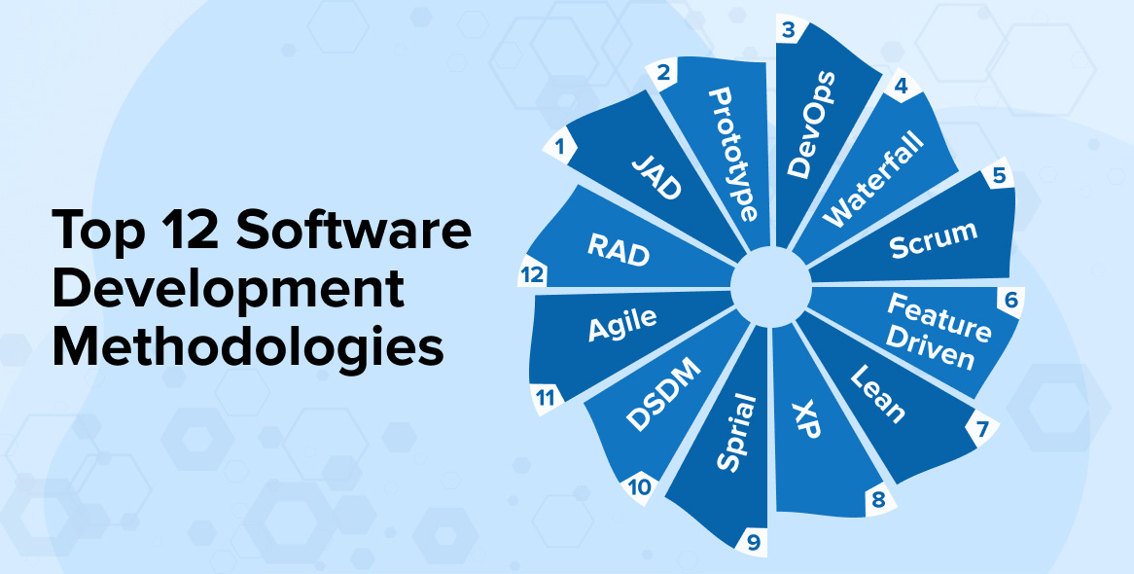

Slide 8
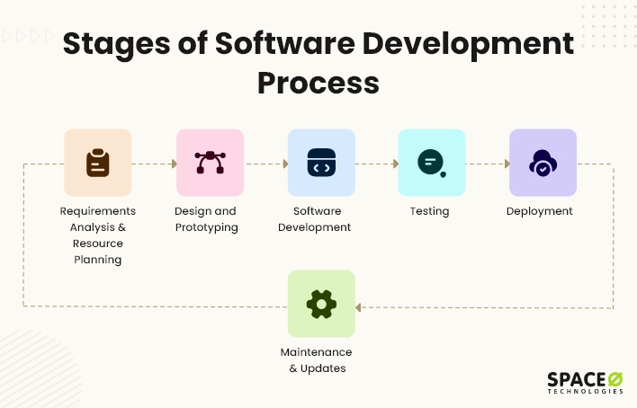

Slide 9
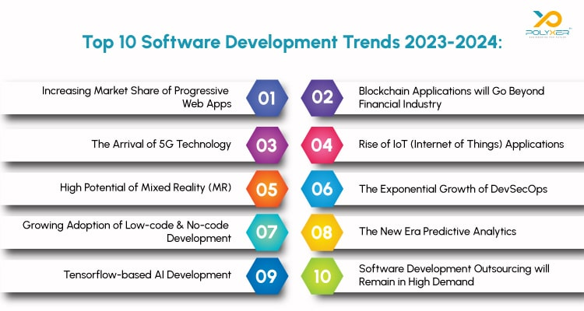

Slide 10
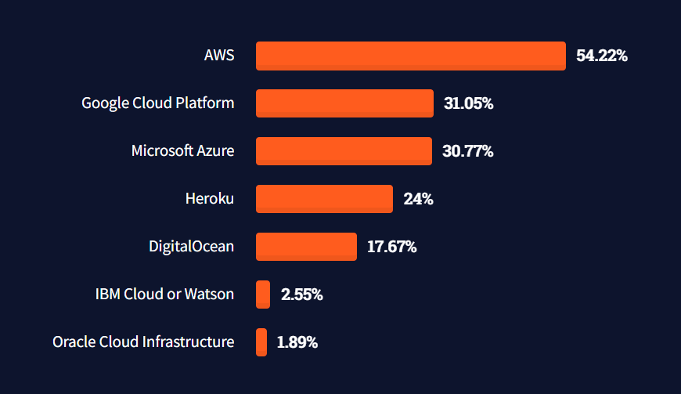
Software Engineering Statistics

Slide 11



Power of Software Engineering Principles
Improved Quality
Improved Performance
Reduces Complexities
Reduced Development Time & Saves Development Costs

Slide 12


Software Development Risks
Schedule Risks
Budget Risks
Management Risks
4. Technical Risks
5. External Risks

Slide 13
Industry Cloud Platforms

Slide 14


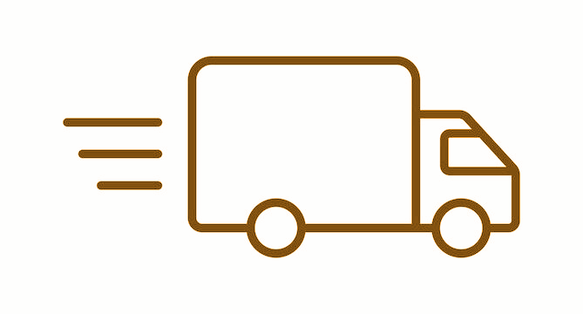
Industry Cloud Platforms
Store Personal and Financial Information
Process Online Transactions
Set Up Delivery Details for Customers

Slide 15
Cloud Platform Benefits
Scalability
Speed
Cost-Effective Maintenance
Security
Automation

Slide 16
40% of shoppers
wait no more than
three seconds before
abandoning a retail site.

Slide 17


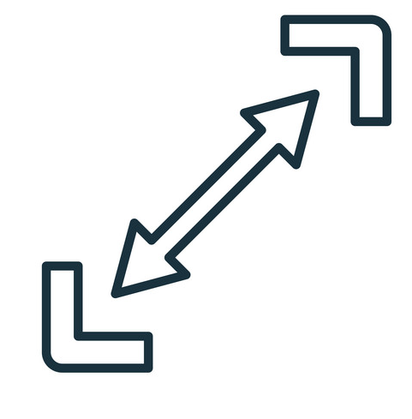

IT Initiatives
Implementation
Data Analytics
Scalability
Security

Slide 18
The average cost of a data breach was
$4.24 million
in 2022.

Slide 19

Data Breach Costs
Loss of Consumer Trust
Loss of Vendor Trust
Legal and Consulting Fees

Slide 20
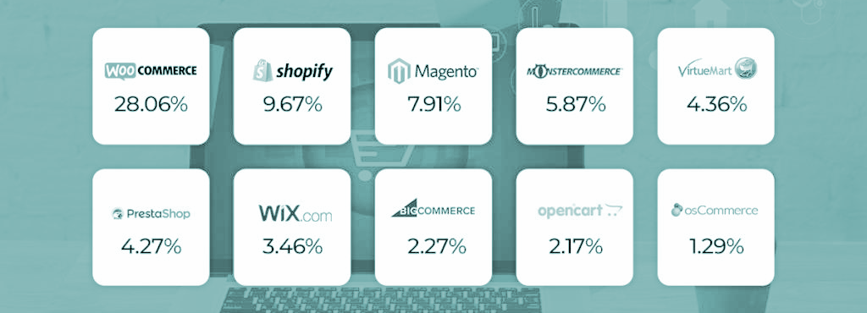
Popular Cloud Platform Outsourced Options

Slide 21

Generative AI

Slide 22
What is Generative AI?
AI that creates new content
Learns from existing data
Applications across industries
Enhances user experiences

Slide 23
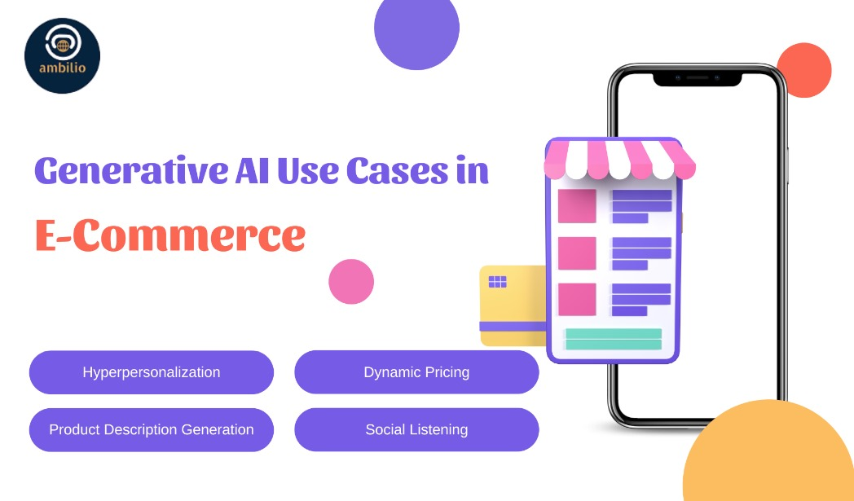
Generative AI Benefits
1. Increases customer engagement significantly.
2. Streamlines operational processes effectively.
3. Improves accuracy of demand forecasting.
4. Enhances overall shopping experience.

Slide 24
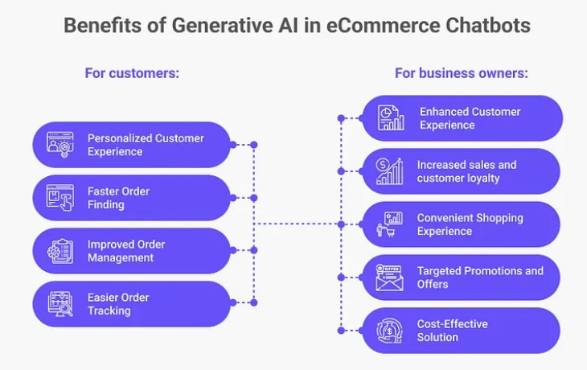

Slide 25
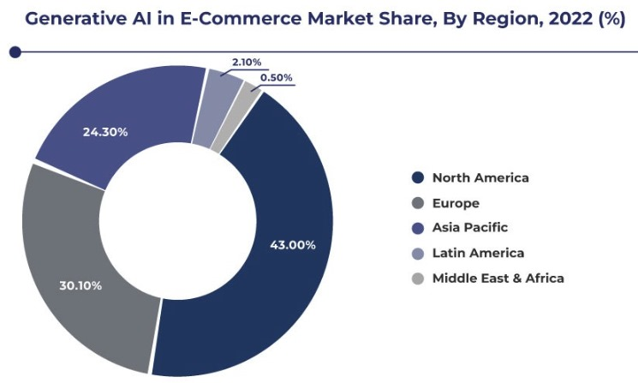

Slide 26
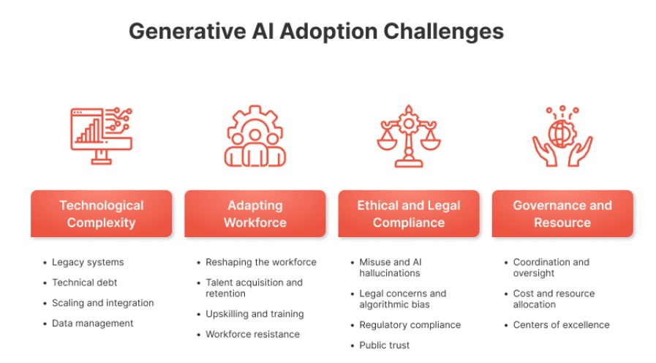

Slide 27
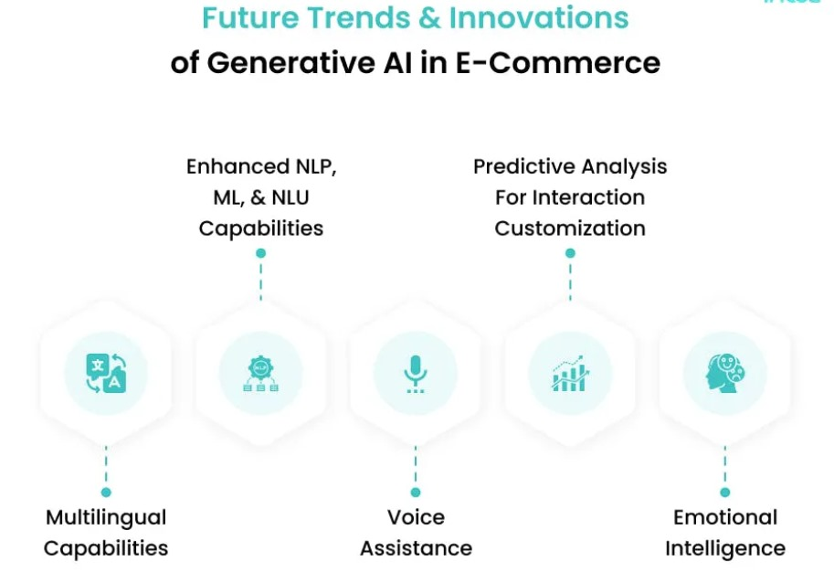

Slide 28
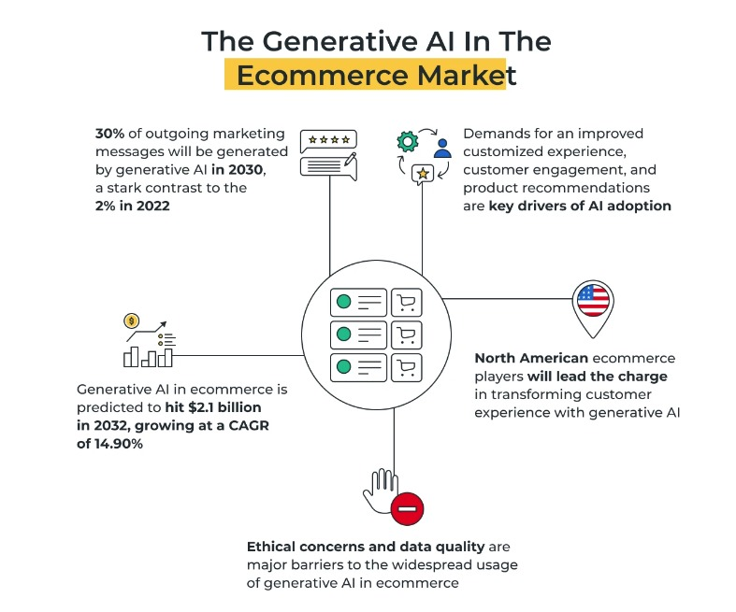

Slide 29
Cybersecurity Mesh Architectures

Slide 30
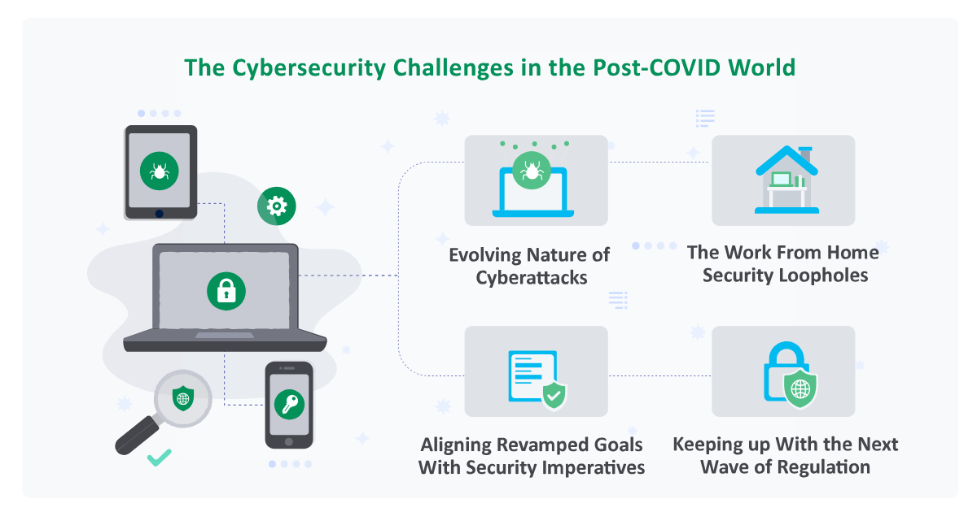
Cybersecurity Mesh Architectures
Protects users
from cyber attack
Decentralized
security control
Adaptive &
real time response
Provides confidence to
users & builds trust

Slide 31
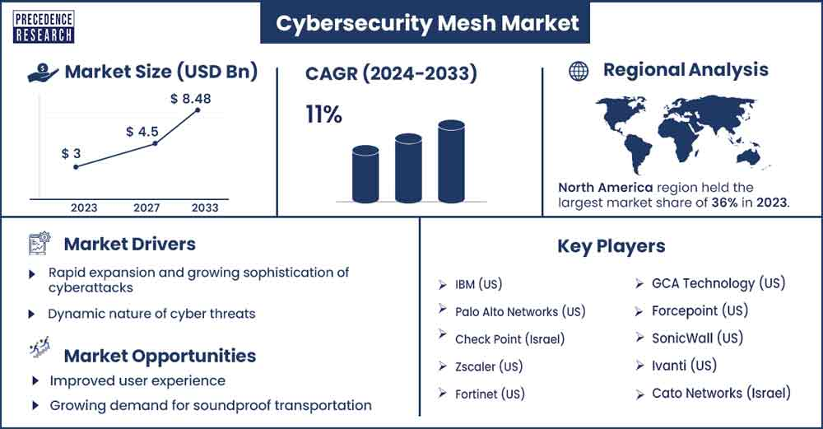
Cybersecurity Market

Slide 32
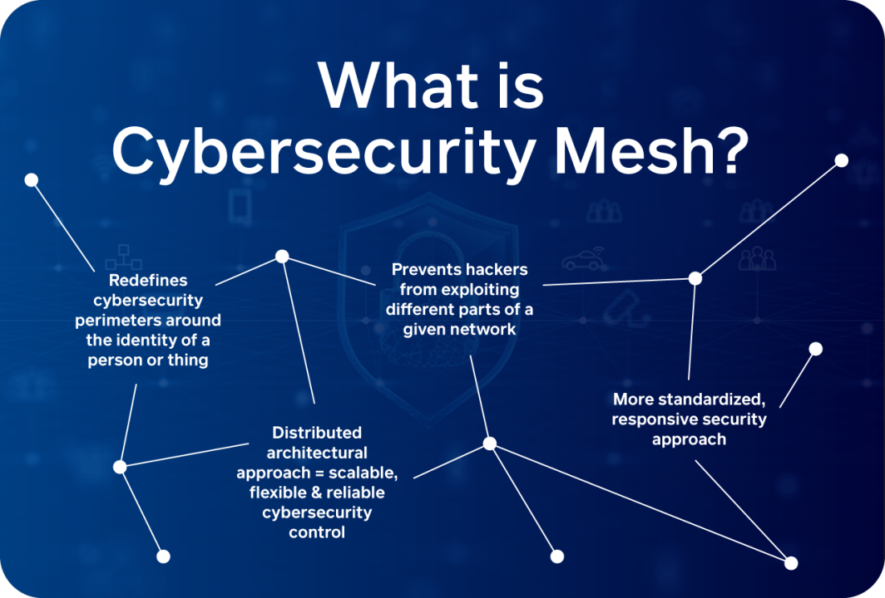
Overview
Interoperability
Emphasizes seamless collaboration
among security controls in mesh
Adaptive Response
Adapts and responds in real-time to
emerging threats, resilience against
Cyber attacks
Decentralized Security Controls
Distributes security controls throughout the entire digital ecosystem, reducing reliance on fixed boundaries

Slide 33

Benefits for E-commerce Applications
Enhanced Resilience and Business Continuity:
Reduces security incidents by
mitigating single points of failure.
Minimizes the risk movement
within the network.
Ensures business continuity and
operational resilience
Compliance with Regulatory Standards
Security controls and measures to
meet regulatory mandates.
Data privacy regulations, customer privacy
Protect Customer Data in Online Transactions
Cost effective
Scalable and flexible

Slide 34
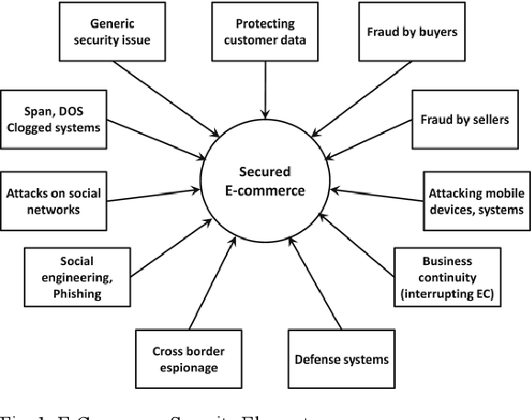
Challenges in eCommerce security
Protection of Customer Data
Secure Online Transactions
Evolving Cyber Threats
Compliant to Regulatory Standards
Third-Party Risks
Scalability and Performance

Slide 35
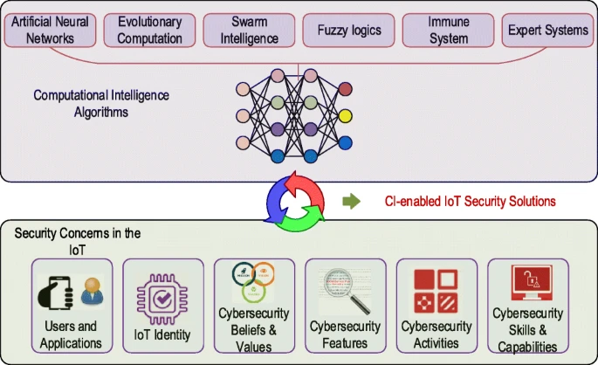
Future Trends and Innovations
Zero Trust Security Model
Integrate with AI & Machine Learning
Quantum-Safe Cryptography
Distributed Ledger Technology
Edge Computing and IoT Security

Slide 36
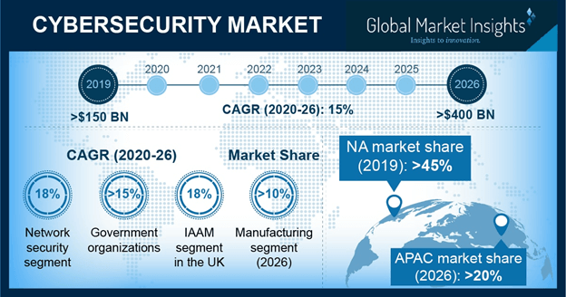
Cybersecurity Market in future

Slide 37
Conclusion
All of these technologies are further advancing the e-commerce industry.
Stakeholders are benefitting massively from them.
Businesses that do not utilize these technologies will be outperformed by competitors.

Slide 38
Thank you!

Slide 39
Sources
https://blog.techliance.com/best-ecommerce-platforms/
https://www.matellio.com/blog/cloud-based-ecommerce-platform/
https://www.upguard.com/blog/cost-of-data-breach#:~:text=Data%20Breaches%20in%20Hybrid%20Cloud,in%20a%20private%20cloud%20environment
https://asponte.com/leveraging-generative-ai-in-e-commerce-a-new-era-of-personalization/
https://chatbotslife.com/generative-ai-chatbot-in-ecommerce-use-cases-benefits-and-statistics-behind-c54b0e83edb2
https://www.linkedin.com/pulse/generative-ai-e-commerce-market-present-development-strategy-sharma/
https://www.intuz.com/blog/generative-ai-chatbots-for-ecommerce-customer-support

